Slide 1
Optical Flow for Estimation of Motion Parameters under Camera Translation

Slide 2
Introduction
Optical flow refers to the apparent motion of brightness patterns in an image sequence.
It represents how pixels move between two consecutive frames.
When a camera moves translationally (without rotation), the observed optical flow is caused by changes in the 3D scene projection on the image plane due to the camera’s movement.
Optical flow thus provides a way to infer camera motion parameters—such as the translation direction and magnitude—and the depth structure of the scene.

Slide 3
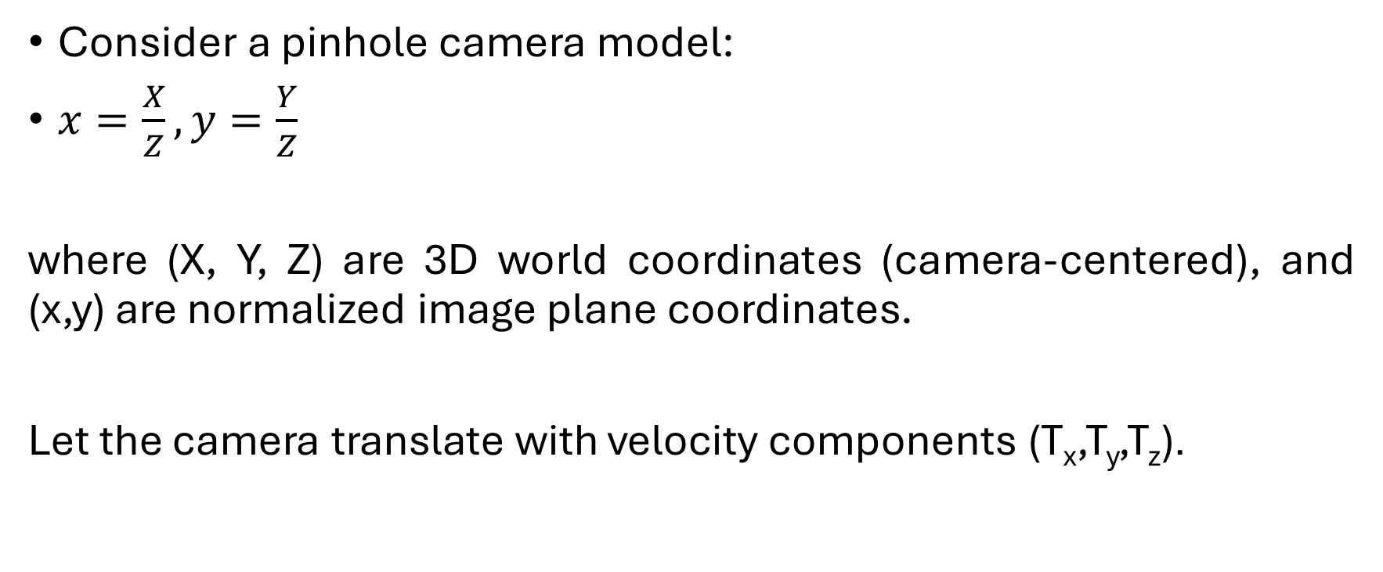
Image Formation Model
Consider a pinhole camera model:
$x=\frac{X}{Z}, y=\frac{Y}{Z}$
where (X, Y, Z) are 3D world coordinates (camera-centered), and (x,y) are normalized image plane coordinates.
Let the camera translate with velocity components (T_{x},T_{y},T_{z}).

Slide 4
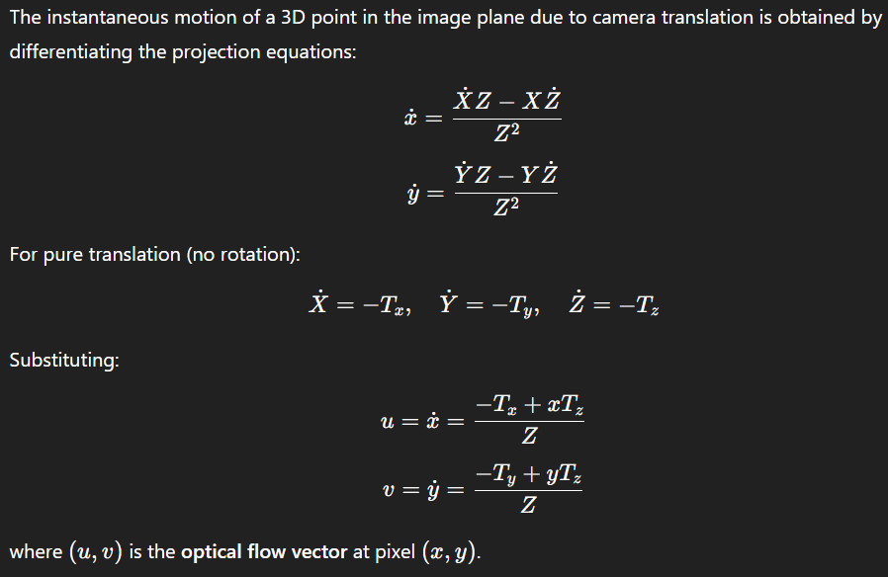
Motion of Image Points (Optical Flow Equations)

Slide 5
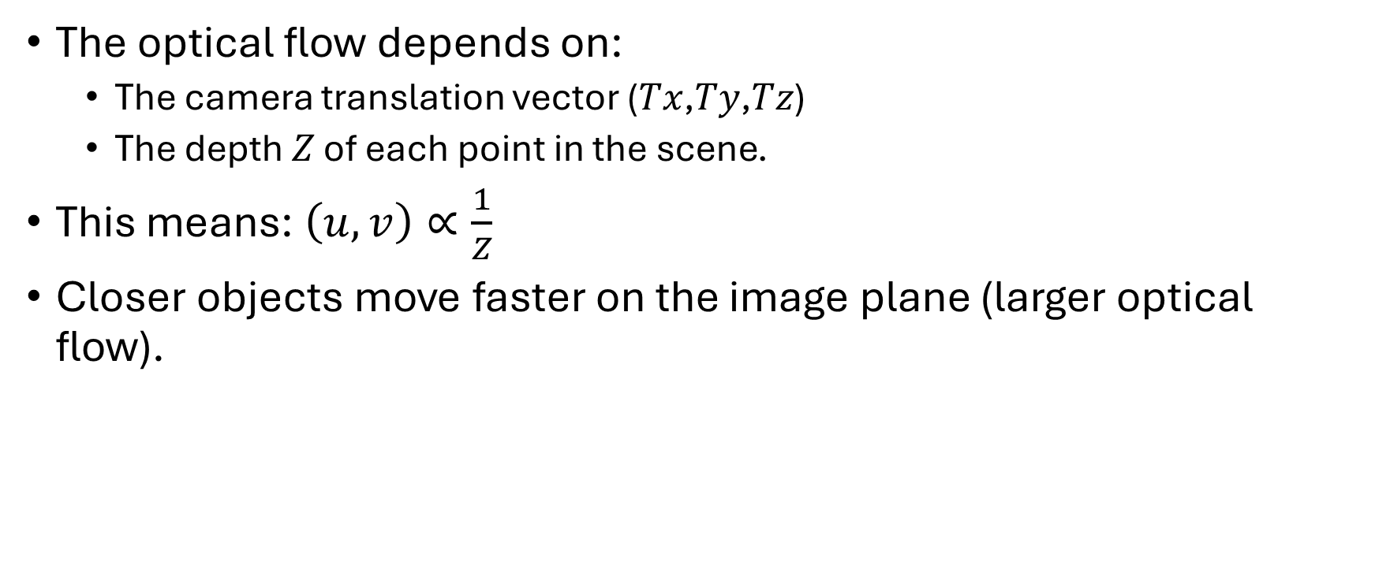
Interpretation
The optical flow depends on:
The camera translation vector (𝑇𝑥,𝑇𝑦,𝑇𝑧)
The depth 𝑍 of each point in the scene.
This means: $\left(u,v\right)∝\frac{1}{Z}$
Closer objects move faster on the image plane (larger optical flow).

Slide 6
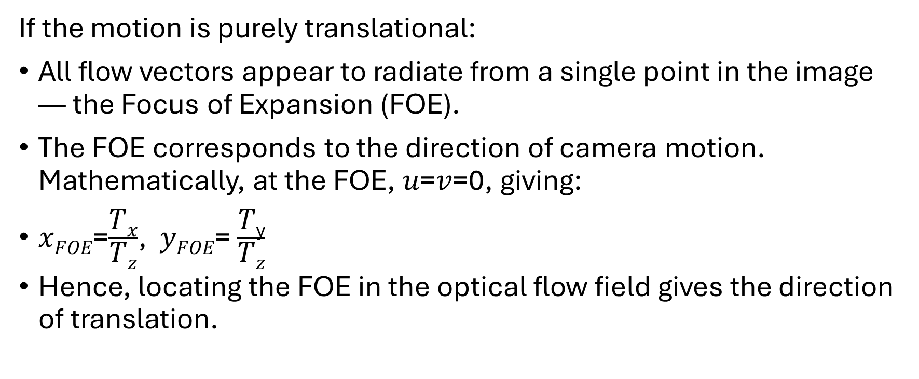
Focus of Expansion (FOE)
If the motion is purely translational:
All flow vectors appear to radiate from a single point in the image — the Focus of Expansion (FOE).
The FOE corresponds to the direction of camera motion. Mathematically, at the FOE, 𝑢=𝑣=0, giving:
𝑥_{𝐹𝑂𝐸}=$\frac{\text{T}\text{x}}{\text{T}\text{z}}$, 𝑦_{𝐹𝑂𝐸}= $\frac{\text{T}\text{y}}{\text{T}\text{z}}$
​Hence, locating the FOE in the optical flow field gives the direction of translation.

Slide 7
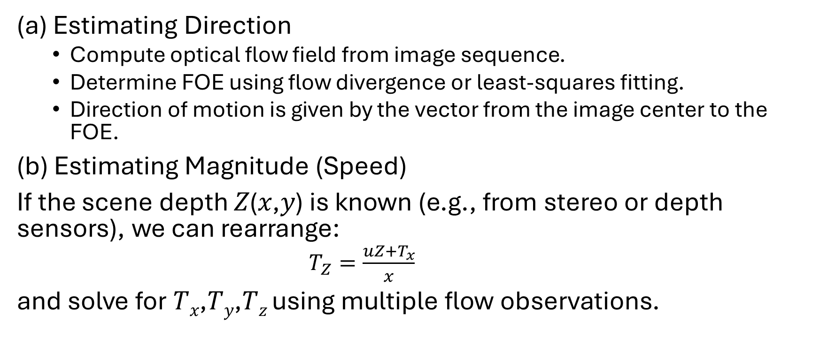
Estimation of Motion Parameters
(a) Estimating Direction
Compute optical flow field from image sequence.
Determine FOE using flow divergence or least-squares fitting.
Direction of motion is given by the vector from the image center to the FOE.
(b) Estimating Magnitude (Speed)
If the scene depth 𝑍(𝑥,𝑦) is known (e.g., from stereo or depth sensors), we can rearrange:
$T_{Z}=\frac{uZ+T_{x}}{x}$ ​
​and solve for 𝑇_{𝑥},𝑇_{𝑦},𝑇_{𝑧}​ using multiple flow observations.

Slide 8
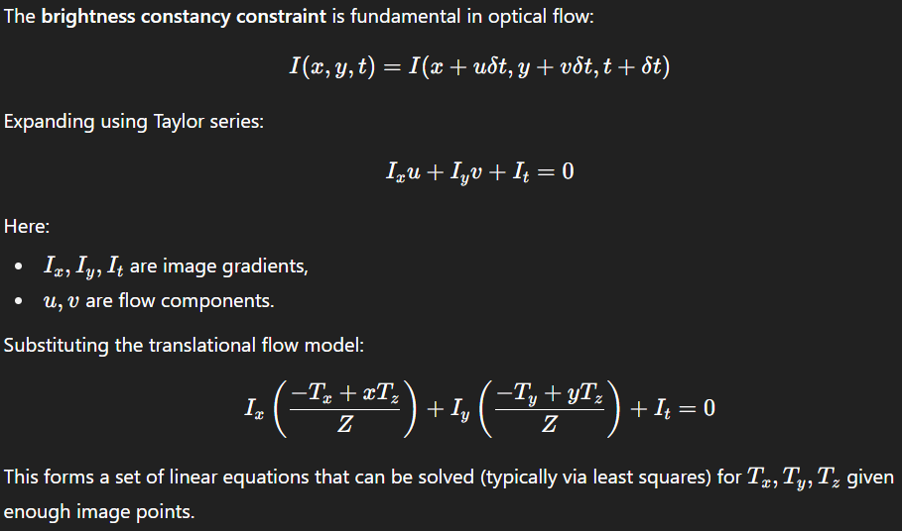
Differential Formulation (Brightness Constancy)

Slide 9
Practical Considerations
Depth ambiguity: Optical flow alone cannot separate translation speed and scene depth without additional constraints.
Small motion assumption: Linear approximations hold for small inter-frame displacements.
Noise and texture: Reliable flow estimation requires textured regions.

Slide 10
Applications
Ego-motion estimation for mobile robots and drones.
Structure-from-motion (SfM).
Visual odometry.
Obstacle avoidance (using FOE and flow divergence).

